Slide 1
LECTURE ON
COMPLEMENTS OF NUMBER

Slide 2
COMPLEMENTS OF NUMBERS
Complements are used in digital computers to simplify the subtraction operation and for logical manipulation.
There are two types of complements for each base-r system:
the radix complement and the diminished radix complements.
The first is referred to as the r’s complements and the second as the (r-1)’s complement.

Slide 3
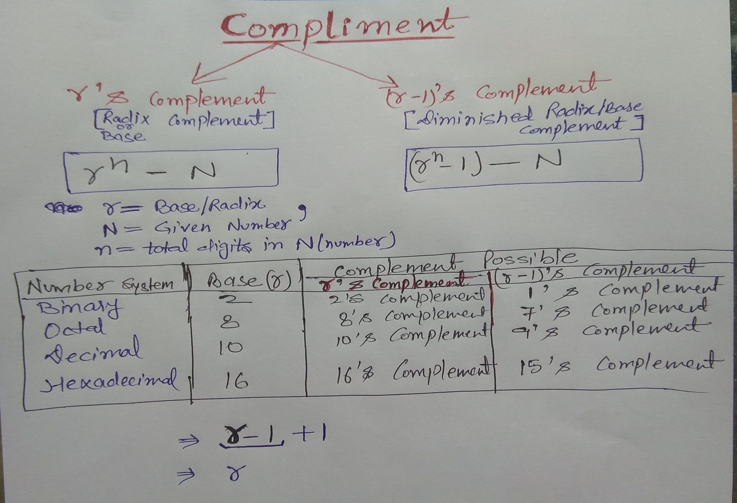

Slide 4
Complement of a number with any base b
Steps to find (r-1)’s complement:
To find (r-1)’s complement, Subtract each digit of the number from the largest number in the number system with base .
For example, if the number is a three digit number in base 10, then subtract the number from 999 as 9 is the largest number in base 10 number system.
Steps to find r’s complement:
To find r’s complement, just add 1 to the calculated (r-1)’s complement.
Now this holds true for any base in the number system that exists. It can be tested with familiar bases that is the 1’s and 2’s complement

Slide 5
9’s Complements
The 9' complement of a number given in decimal representation is formed by replacing each digit with nine minus that digit.
Ex 1: 9’s complement of 674653
999999-674653 = 325346
Ex2 9’s complement of 023421
999999-023421 = 976578
Ex3 9’s complement of 256
999-256= 743

Slide 6
10’s Complements
Ex1: 10’s complement of 674653
9’s complement of 674653
999999-674653 = 325346
Then Add 1
325346+1 = 325347
Ex2: 10’s complement of 023421
9’s complement of 023421
999999-023421 = 976578
Then add 1
976578+1=976579
Ex3: 10’s complement of 256

Slide 7
1’s Complements
Ex1: 1’s complement of 10111001
11111111 – 10111001 = 01000110
OR
Simply replace 1’s and 0’s
10111001 = 01000110
Ex2: 1’s complement of 10100010
01011101
Ex3: 1’s complement of 01011111
?????

Slide 8
2’s Complements
Ex1: 2’s complement of 10111001
1’s complement of 10111001
01000110
Then Add 1 to 1’s complement
01000110 + 1 = 01000111
Ex2: 2’s complement of 10100010
1’s complement of 10100010
01011101
Then Add 1 to 1’s complement
01011101 + 1 = 01011110

Slide 9
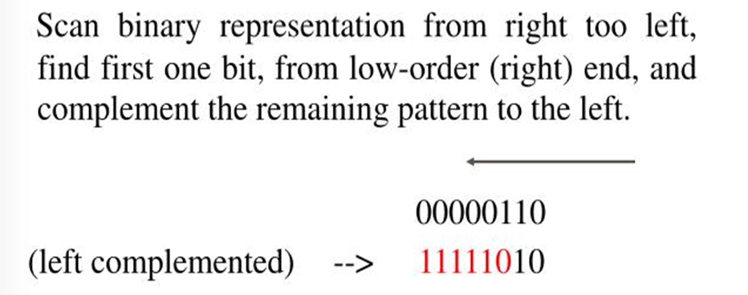
Alternative method for 2’s Complement

Slide 10
Alternative method for 2’s Complement
Ex1: 2’s complement of 10111001
01000111
Ex2: 2’s complement of 10100010
01011110
Ex3: 2’s complement of 10100010

Slide 11
7’s Complements
Ex 1: 7’s complement of 245
777-245 = 532
Ex2 7’s complement of 1157
7777-1157=6620

Slide 12
8’s Complements
Ex 1: 8’s complement of 245
first 7’s complement of 245
777-245 = 532
Then ADD 1
532+1=533
Ex2 8’s complement of 1157
first 7’s complement of 1157
7777-1157=6620
THEN ADD 1 IN 7’S COMPLEMENT
6620+1=6621

Slide 13
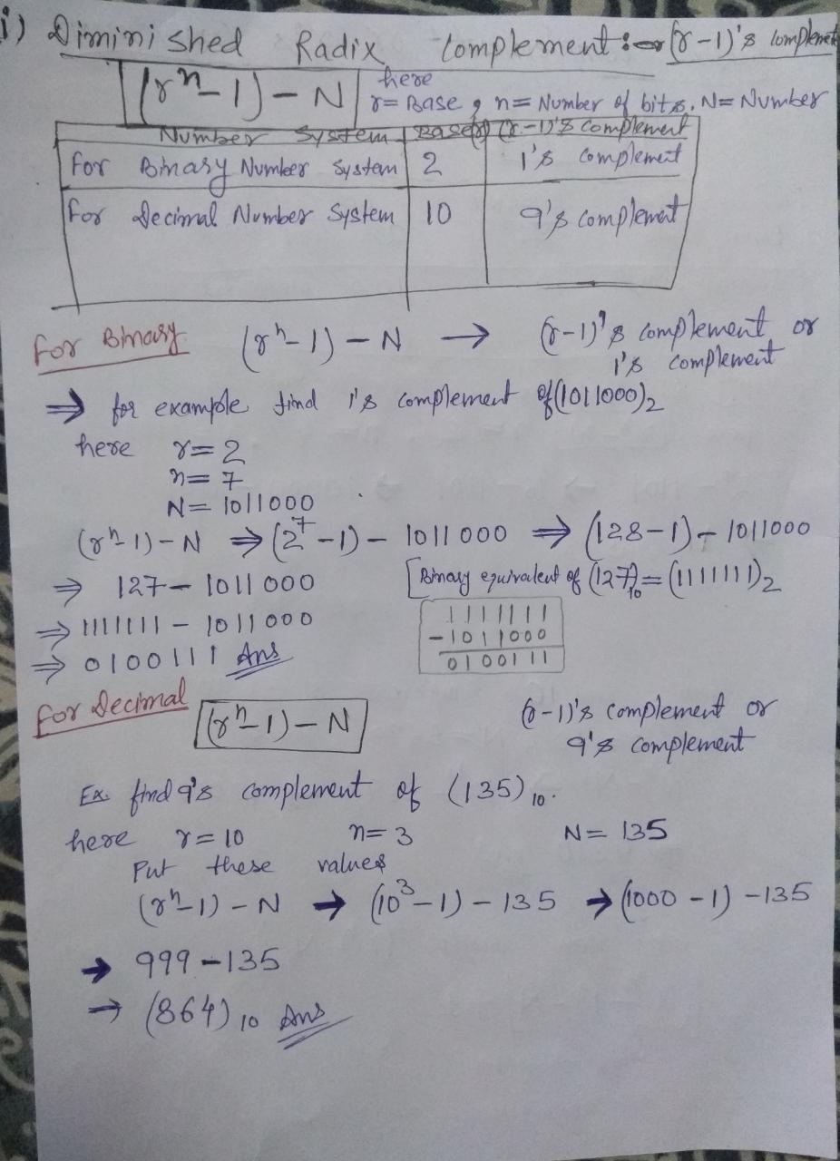

Slide 14
